Slide 1


Jaime Solis
June 28th, 2022

Slide 2


Table of Contents
Executive Summary
Introduction
Methodology
Results
Conclusion
Appendix

Slide 3

Executive Summary
SpaceY, a new rocket launch company, wants to compete with SpaceX.
SpaceX advertises Falcon 9 rocket launches on its website with a cost of 62 million dollars; other providers cost upwards of 165 million dollars each, much of the savings is because SpaceX can reuse the first stage.
If it can be determined if the first stage will land, it can be determined the cost of a launch.
After collecting and analyzing data some models were trained to predict if the first-stage rocket booster will land successfully after a launch with an accuracy level of 83.33%, given some parameters like payload mass and desired orbit.
As a result, SpaceY will be able to make more informed bids against SpaceX by using 1st stage landing prediction as a proxy for launch costs.

Slide 4

Introduction — Backgound
This report has been prepared as the final deliverable for the Applied Data Science Capstone course, part of IBM Data Science Professional Certification.
In this project, the Data Science methodology has been followed, involving data collection, data wrangling, exploratory data analysis, data visualization, model development, model evaluation, and reporting results.
Using data science findings and models, the data science team of the fictional company SpaceY, will be able to make more informed bids against SpaceX for a rocket launch.

Slide 5

Introduction — Business Problem
SpaceX advertises Falcon 9 rocket launches on its website, with a cost of 62 million dollars; other providers cost upward of 165 million dollars each, much of the savings is because SpaceX can reuse the first stage.
Therefore, this report aims to accurately predict the likelihood of the first stage rocket landing successfully as a proxy to determine the cost of a launch, using parameters like payload mass, desired orbit, and launch site, among others.

Slide 6

Section 1

Slide 7
Methodology
For this report, the data science methodology followed can be outlined as such:
2nd step
1st step
Data Collection
Data Wrangling
3rd step
Reporting Results
Perform exploratory data analysis
(EDA)
4th step
5th step
Data visualization
Model Development

Slide 8

Data Collection
1) API
Historical launch data from SpaceX REST API
Filtered data to include only Falcon 9 launches
Request and parse the SpaceX launch data using the GET request
Replaced missing payload mass values with mean
2) Web Scraping
Historical launch data from a Wikipedia page called “List of Falcon 9 and Falcin Heavy Launches[
Extract all column/variable names from the HTML table header
Falcon 9 launch dataset was limited to launches before December 2020 per instructions
Request the Falcon9 Launch Wiki page from its URL with BeatifulSoup
Created a data frame by parsing the launch HTML tables

Slide 9
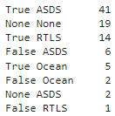
Data Wrangling
Explored data to determine the label for training supervised models
Calculated the number of launches on each site
Calculated the number and occurrence of each orbit
Calculated the number and occurrence of mission outcome per orbit type
Created a landing outcome label ‘Class’ from Outcome column
First stage booster did not land successfully Class = 0
None None: not attempted None ASDS: unable to be attempted due to launch failure False ASDS: drone ship landing failed False Ocean: ocean landing failed False RTLS: ground pad landing failed
.
First stage booster landed successfully Class = 1
True ASDS: drone ship landing succeeded True RTLS: ground pad landing succeeded True Ocean: ocean landing succeeded

Slide 10

Exploratory Data Analysis
a) with SQL
Ran SQL queries to display information about
Launch sites
Payload masses
Booster versions
Mission outcomes
Booster landings
b) with visualization
Used Matplotlib and Seaborn libraries to plot
Flight Number x Payload Mass
Flight Number x LaunchSite
Payload x LaunchSite
Orbit type x Success rate
Flight Number x Orbit type
Payload x Orbit type
Year x Success rate

Slide 11

Data Visualization
Launch Sites Location Analysis
Used Folium, an interactive mapping library for Python
Marked all launch sites on map
Marked the successful/failed launches for each site
Calculated distances between a launch site and its proximities
Launch Records Dashboards
Used Plotly Dash, an interactive dashboarding library for Python
Added pie chart showing success rate by site
Added scatter chart showing payload mass vs landing outcome
Added drop-down menu to choose between all sites and individual launch site
Added range slider for limiting payload amount

Slide 12
Predictive Analysis (Classification)
Created a column for training label ‘Class’
Used cross-validated grid-search with hyperparameter to select the best ones
Split data into
train and test sets
Created during data wrangling
GridSearchCV
Imported libraries and load data frame
Standardized the data
Fit training data to models
Evaluated accuracy of each model using test data to select the best model
Pandas
Numpy
Matplotlib
Seaborn
Scikit-learn
Logistic Regression
SVM
Decision Tree
KNN

Slide 13

Results
Exploratory data analysis results
Interactive analytics demo
Predictive analysis results

Slide 14

Section 2

Slide 15
EDA with SQL
Names of the launch sites CCAFS LC-40 CCAFS SLC-40 KSC LC-39A VAFB SLC-4E
Records where launch sites begin with `CCA` Last launch from CCAFS LC-40 was 2016-08-14 First launch from CCAFS SLC-40 was 2017-12-15
Total payload carried by boosters from NASA 45,596 KG.
Average payload mass carried by booster version F9 v1.1 2,534 KG
The dates of the first successful landing outcome on ground pad 01-05-2017

Slide 16
EDA with SQL
Names of boosters that have successfully landed on a drone ship and had payload mass greater than 4000 but less than 6000 F9 FT B1022
F9 FT B1026
F9 FT B1021.2
F9 FT B1031.2
The total number of successful and failed mission outcomes Failure (in flight) 1 Success 99 Success (payload status unclear) 1
Names of the booster which have carried the maximum payload mass B1048.4, B1049.4, B1051.3, B1056.4, B1048.5, B1051.4, B1049.5, B1060.2, B1058.3, B1051.6, B1060.3, B1049.7
Failed landing_outcomes in drone ship, their booster versions, and launch site names for in year 2015 January F9 v1.1 B1012 CCAFS LC-40 Failure (drone ship) April F9 v1.1 B1015 CCAFS LC-40 Failure (drone ship)

Slide 17
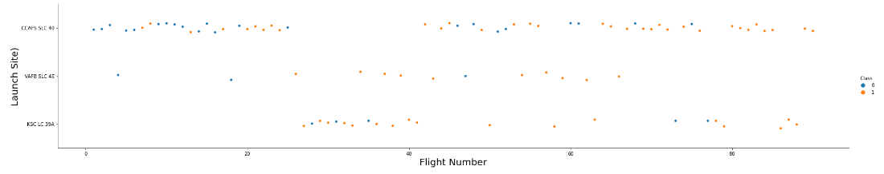
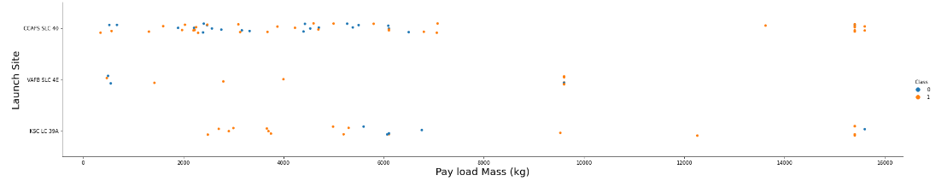
EDA with Visualization
Launch Site vs Flight Number
CCAFS SLC 40 has more flights than the other launch sites combined and the first third of them were mostly failures but as the flight number increases, the first stage is more likely to land successfully.
Launch Site vs Payload Mass
VAFB-SLC launch site there are no rockets launched for heavy payload mass(greater than 10000).

Slide 18
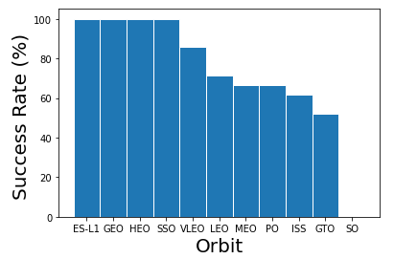
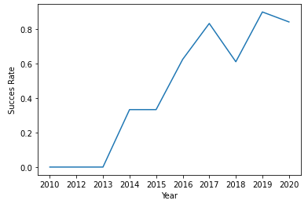
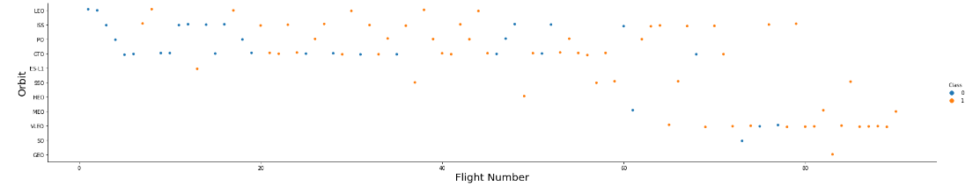
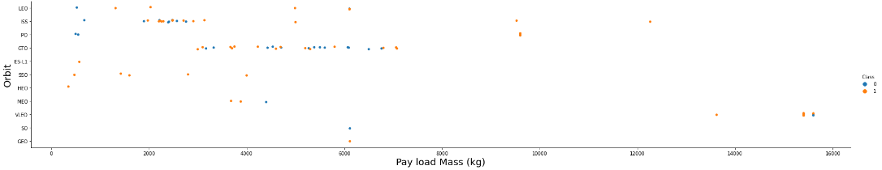
EDA with Visualization
Success rate of each orbit type
Yearly average success rate
All orbit types have had successful landings except “SO”
The success rate since 2013 kept increasing till 2020
Orbit type vs Flight number
In the LEO orbit the Success appears related to the number of flights; on the other hand, there seems to be no relationship between flight number when in GTO orbit
Orbit type vs Payload Mass
With heavy payloads the successful landing or positive landing rate are more for Polar, LEO and ISS. However, for GTO it cannot be distinguished this well as both positive landing rate and negative landing(unsuccessful mission) are both there here.

Slide 19

Section 3

Slide 20
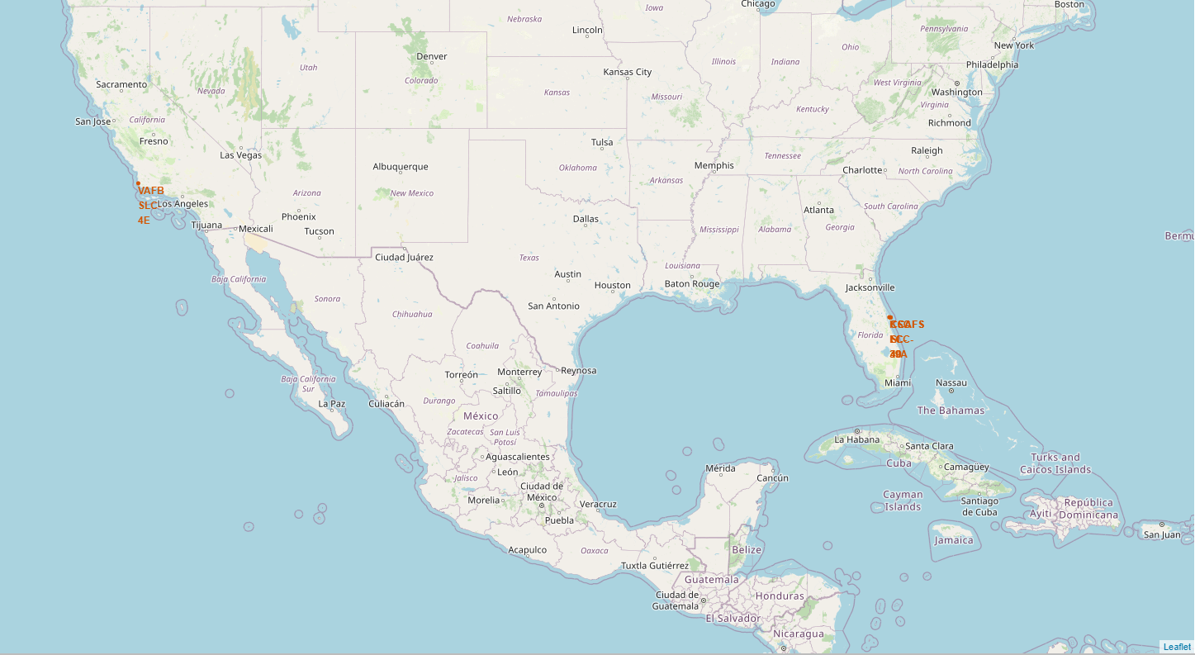
All Launch Sites
Visualizing all the launch sites on a map help to highlight the importance of launch site proximity to coasts and the equator.

Slide 21
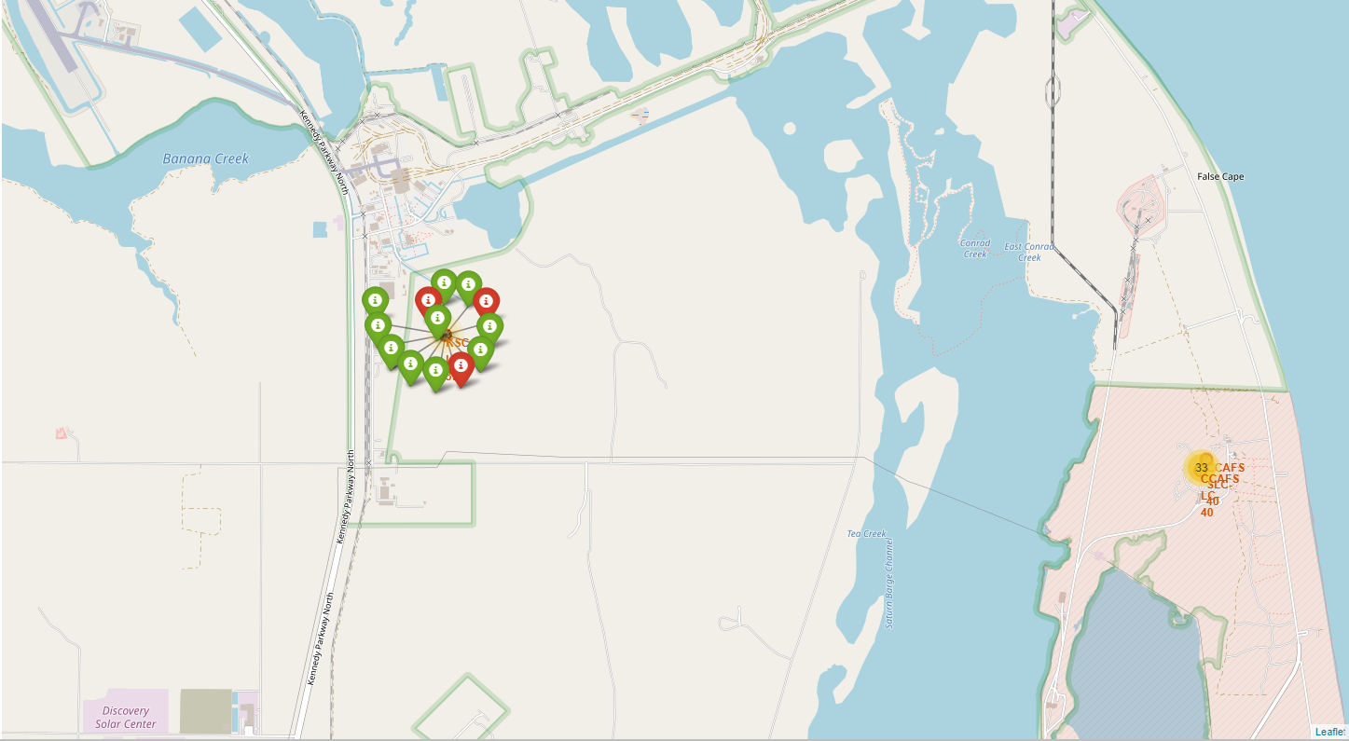
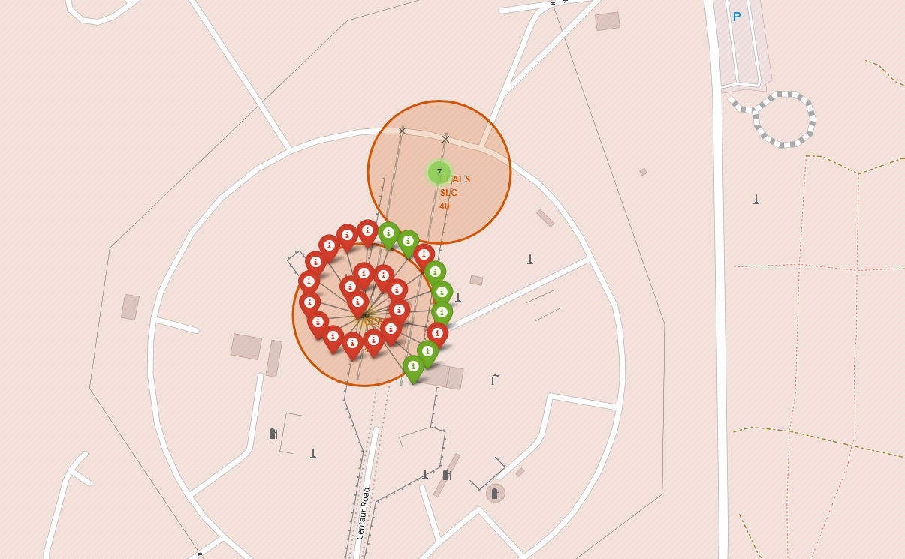
Success/failed launches for each site
Visualizing landing outcomes for each launch site highlights which launch sites have relatively high success rates.

Slide 22
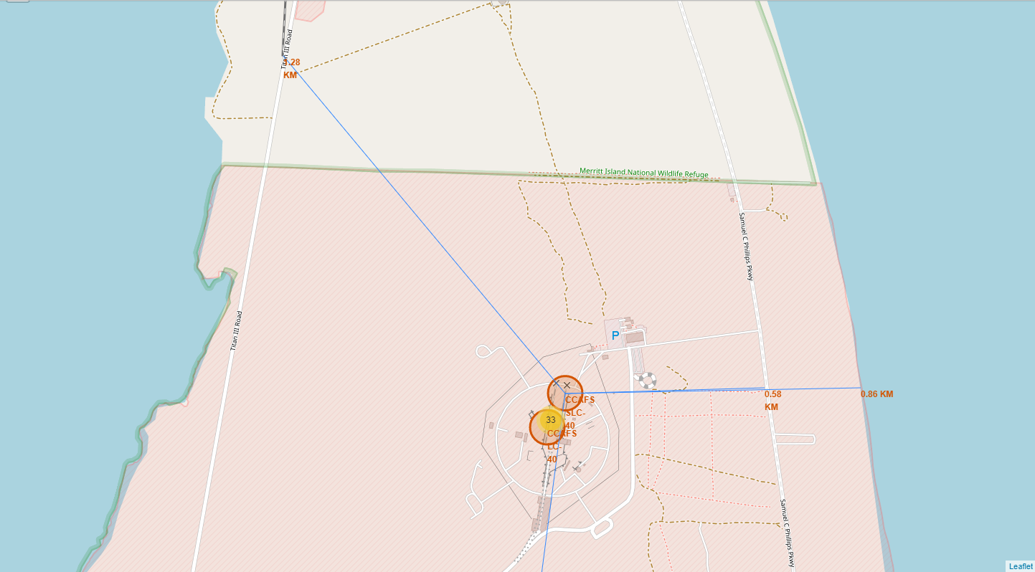
Distances between a launch site to its proximities
Visualizing proximities with railways, highways, coastlines and cities allows to conclude that launch sites are near railways (the transport for heavy cargo), highways(for easily transport required people and equipment), and coastlines (so they can fly over the ocean during launch if a launch abort is required and attempt a water landing to minimize risk for people and property from falling debris).
Launch sites are not in close proximity to cities, which minimizes danger to population-dense areas.

Slide 23

Section 4

Slide 24
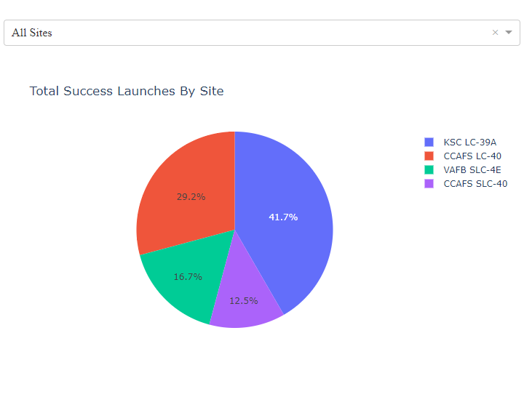
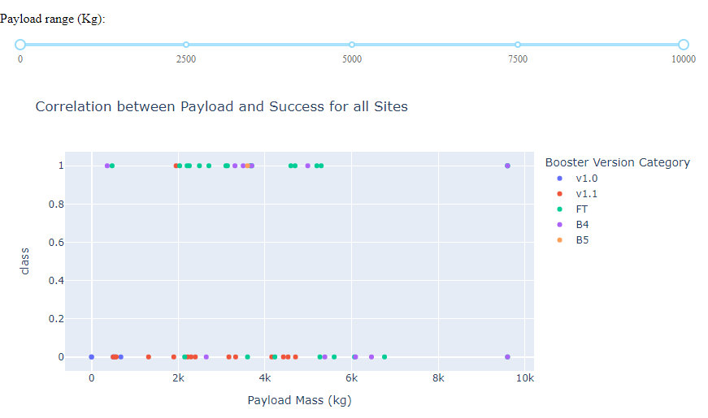
SpaceX Launch Records Dashboard
KSC LC-39A is the launch site with the highest landing success rate considering all launches
The heavier the payload is, the more likely failure landing is
VAFB SLC-4E has the heaviest succesful landing.

Slide 25
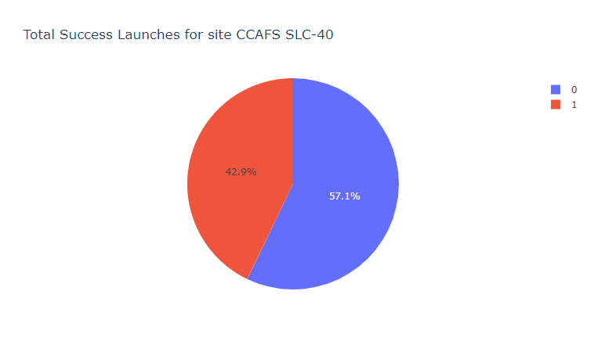
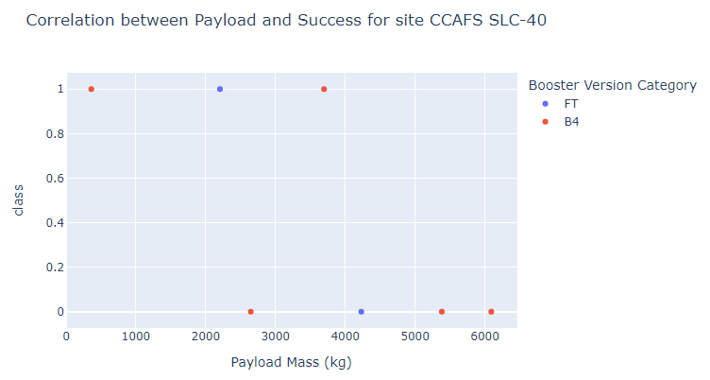
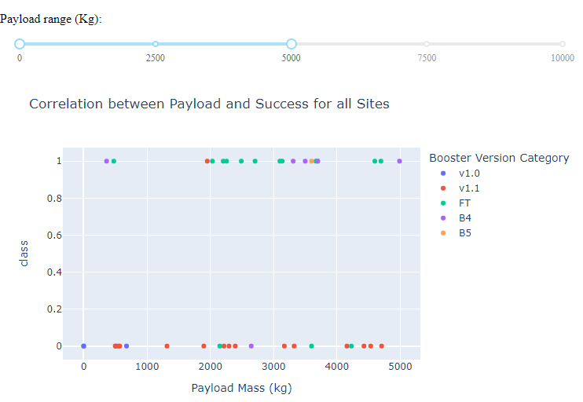
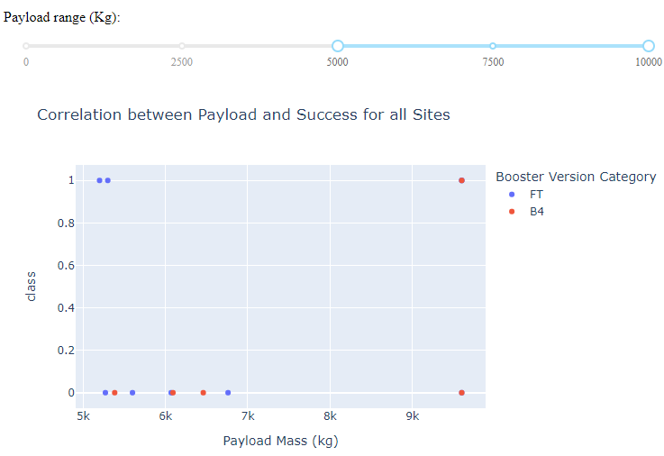
Observations
CCAFS SLC-40 is the launch site with the highest success rate of 42.9%.
Payloads < 5000 kg have higher booster landing success.

Slide 26

Section 5

Slide 27
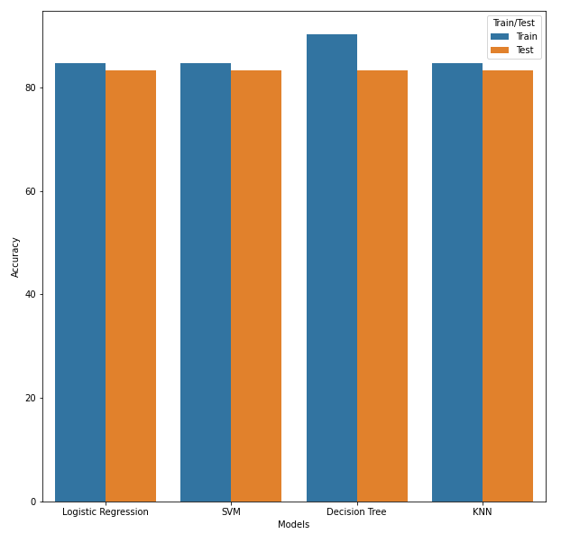
Classification Accuracy
All models performed practically the same, except for the Decision Tree Model which fitted better on train data but worse on test data.
Each of the four models retrieved the same accuracy score of 83.33%

Slide 28
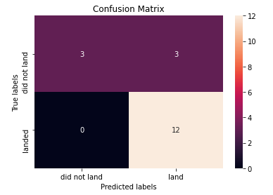
Confusion Matrix
The confusion matrices for all four models are the same.
The main issue with the models is false positives as they incorrectly predicted 3 failure landings as successful ones out of 18 samples in the test set.

Slide 29
Conclusions
Using the models from this report SpaceY can predict when SpaceX will successfully land the 1st stage booster with 83.3% accuracy
This will enable SpaceY to make more informed bids against SpaceX, since they will have a good idea of when to expect the SpaceX bid to include the cost of sacrificed 1st stage booster
Biggest opportunities going forward to make even more informed bids:
Retrain the models with the whole dataset using the same hyperparameters previously defined
Incorporate additional launch data to the dataset and model as it becomes available

Slide 30
Appendix
Notebook files to recreate this same project can be found on this github repository: https://github.com/JaimeSolisS/IBM-Applied-Data-Science-Capstone
Collect data: https://github.com/JaimeSolisS/IBM-Applied-Data-Science-Capstone/blob/main/01-Collecting_the_Data/01-spacex-data-collection-api.ipynb https://github.com/JaimeSolisS/IBM-Applied-Data-Science-Capstone/blob/main/01-Collecting_the_Data/02-webscraping.ipynb
Data Wrangling https://github.com/JaimeSolisS/IBM-Applied-Data-Science-Capstone/blob/main/02-Data_Wrangling/01-spacex-Data%20wrangling.ipynb
Exploratory Analysis https://github.com/JaimeSolisS/IBM-Applied-Data-Science-Capstone/blob/main/03-Exploratory_Analysis/01-eda-sql_sqllite.ipynb https://github.com/JaimeSolisS/IBM-Applied-Data-Science-Capstone/blob/main/03-Exploratory_Analysis/02-eda-dataviz.ipynb
Data Visualization https://github.com/JaimeSolisS/IBM-Applied-Data-Science-Capstone/blob/main/04-Interactive_Visual_Analytics_and_Dashboard/01-launch_visual_analytics_folium.ipynb https://github.com/JaimeSolisS/IBM-Applied-Data-Science-Capstone/blob/main/04-Interactive_Visual_Analytics_and_Dashboard/02-spacex_dash_app.py
Predictive Analysis https://github.com/JaimeSolisS/IBM-Applied-Data-Science-Capstone/blob/main/05-Predictive_Analysis_Classification/01-spacex_machine%20_learning_prediction.ipynb
Illustrations from storyset.com
Icons from slidesgo.com

Slide 31


